Slide 1

Import Statement and Dictionaries in Python
MTH 564 – Mathematical Modeling

Slide 2

Installation of Python
Import in Python
import filename
import keyword that tells Python that you want to be able to use all functions, variables, etc. in file given by filename.py.
You can call functions in the file using filename.function_name
import filename as yourname
as keyword that Python that you want to use all functions, variables, etc. in file given by filename.py with shortcut yourname
You can call functions in the file using yourname.function_name
Example: my_func.py, my_func2.py, and my_import.py

Slide 3
Installation of Python
Modules in Python
Why do we use import?
sometimes code gets really long and breaking it up into smaller files makes it easier to maintain and edit
on other occasions you write a nice function that you would like to use several times in different places
A module is a file containing Python definitions and statements.
can contain executable statements that initialize the module
modules can import other modules
modules sometimes have their own variables and constants

Slide 4
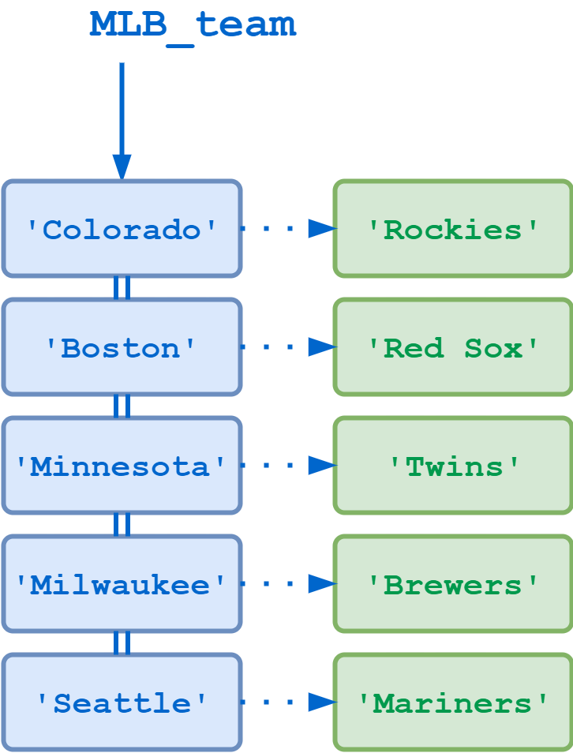
Dictionaries
Python data type (mapping types)
Kind of like an array, but it can be indexed by keys
Basically a dictionary is set of key: value pairs
Keys are typically used to look-up values
Dictionaries are unordered and mutable (can be changed
Used to store Bivariate data

Slide 5

Dictionaries: Look-Up
Ways to look up data
Use array notation with key inside brackets grades[“Joe”]
Use the get function grades.get(“Joe”)
Both of these return 56, the grade for “Joe”
Example: dictionary.py

Slide 6
Dictionaries: Manipulating
You can add and remove entries to a dictionary easily
To add an entry place the new key inside brackets and use = to assign the new value grades[“Bob”] = 78
To remove use the del keyword on the entry del grades[“Joe”]
The dictionary now has Bob but not Joe.
in keyword – use to check if a key appears in a dictionary
returns True of False “Bob” in grades
Example: dictionary.py

Slide 7
Dictionaries: Loops
These can be used to loop through a dictionary:
keys() function – returns a list of all keys in the dictionary
values() function – returns a list of all values in the dictionary
items() function – returns a list of all entries in the dictionary
Example: dictionary.py

